Slide 1






PRESENTS
2025
DATANYX
24 HOUR
DATATHON

Slide 2

2025
DATANYX
TEAM DETAILS
Team Name : ByteCore
Domain : FinTech
Project Title : XAI-Driven ML Framework for Optimizing International Capital Movements
Team Lead : Abdul Nasir
Team Member 1 : Abdul Muizz
Team Member 2 : Shaik Abubakr
Team Member 3 : Syed Suhaib
Name of the college : Lords Institute & MVSR College

Slide 3
2025
PROBLEM STATEMENT & IDEA SOLUTION
DATANYX
PROBLEM STATEMENT
Cross-border capital movement is complex and opaque.
Money loses value due to Currency spreads, taxes, compliance delays, and jurisdiction risks.
Companies often have no visibility into where value leaks across global routes.
India alone lost nearly ₹12,000 crore due to unclear offshore routing and hidden frictions.
No existing system helps compare multi-hop pathways or understand legal routing advantages.
Stakeholders need a tool that can simulate, score, and optimize global capital flows transparently.
IDEA SOLUTION
Simulates 2–3 hop routes across international corridors.
Computes cost, speed, risk, compliance friction, FX, and taxes for each path.
Uses Machine Learning (XGBoost) to predict friction for each corridor.
Uses Explainable AI (SHAP) to show exactly why a route is expensive or risky.
Ranks routes based on user priorities: Cost, Time, and Risk.
Displays Recommended, Cheapest, Fastest, and Safest pathways.
Shows direct-route baseline vs optimized route savings in ₹ and %.
Provides visual graphs, results tables, and per-route explanations.

Slide 4
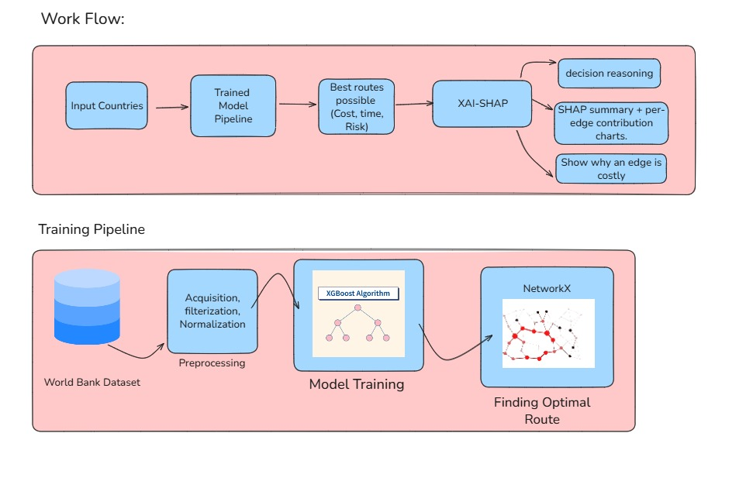
2025
Dataset & Architecture overview
DATANYX
Dataset
Dataset is preprocessed using various techniques such as dimension filtering, normalization etc.
  source_country
  destination_country
  annual_cash_flow_volume
  average_transfer_fee_percentage
  fx_volatility_index
  regulatory_restriction_score
  AML_requirements_score
  avg_payment_processing_time
  correspondent_banking_dependency
  migrant_population_source_to_destination
  internet_penetration_rate
  digital_payment_infrastructure_score
  money_laundering_risk_score
  sanctions_risk
  overall_friction_score (label)
system Architecture

Slide 5
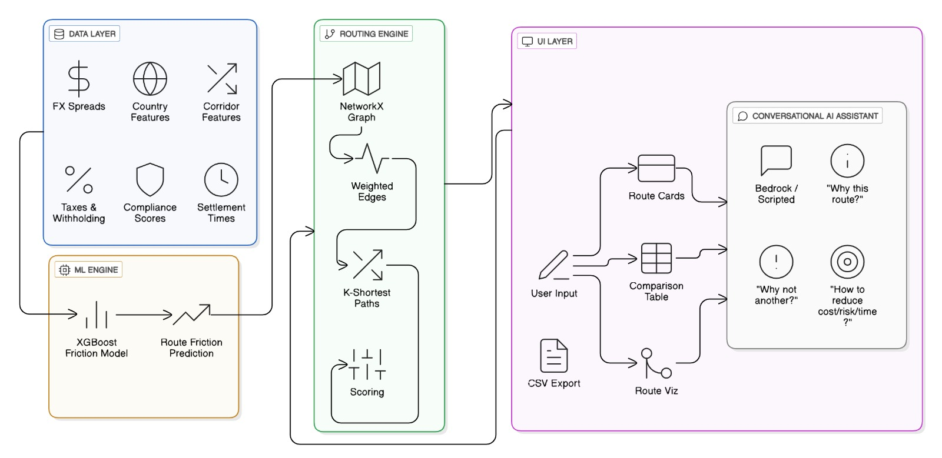
2025
TECH STACK & WORKFLOW
DATANYX
TECH STACK
Machine Learning: XGBoost, SHAP
Graph Routing: NetworkX (multi-hop path discovery)
Frontend/UI: Streamlit
Visualization: Matplotlib / Plotly/Streamlit Graph
Backend/Processing: Python
Data Handling: Pandas, JSON, CSV
AWS: Lambda, S3, API Gateway, SageMaker
WORKFLOW

Slide 6
2025
TECH STACK & FEATURES
DATANYX
Features
Multi-hop routing (up to 3 hops).
ML-driven friction scoring per corridor.
Adjustable sliders for Cost / Speed / Risk weighting.
Route cards: Recommended / Cheapest / Fastest / Safest.
CFO-focused comparison table with net received amount & savings.
Node-edge graph visualization of each route.
Direct vs Optimized route comparison (₹ savings + time gain).
Per-route SHAP explanation panel (“Why this route?”).
CSV export for reporting and analysis.
Unique Selling Points (USP)
ML-Driven Friction Modeling: XGBoost predicts hidden costs and frictions between jurisdictions.
Explainable AI: SHAP explains WHY a route is costly — full transparency.
Real-Time Prioritization: Cost/Speed/Risk sliders instantly re-rank routes.
Rich Visualizations: Route graph, SHAP panel, comparison table, and savings breakdown.
Direct vs Optimized Benchmarking: Shows exactly how much money is saved legally.
Enterprise-Ready Flow: Modular architecture with routing engine, UI, and explainability

Slide 7
2025
FEASIBILITY & Impact
DATANYX
Dimension | Before (Current State) | After (With Our System) | Measured Impact
Cost Efficiency | Routing choices driven by guesswork, legacy bank advice, or habit | Data-driven route recommendations based on real corridor friction | Savings of 5–18% per cross-border transfer depending on corridor complexity
Transparency | Hidden charges: FX spread, taxes, compliance and delays are unclear | Full breakdown: per-hop cost, risk, regulation exposure, and settlement dynamics | 100% visibility into where value leaks and why
Speed of Decision-Making | CFOs and treasury teams require days/weeks to evaluate routing | Route simulation and ranking in seconds | Decision cycles drop from days → minutes
Risk Management | Risk understood only post-transaction (delays, holds, freezes) | SHAP-powered predictive scoring on regulatory risk before execution | Avoidable compliance delays reduced by up to 60%
Strategic Planning | Treasury operations reactive and execution-only | Ability to simulate and benchmark routes before sending funds | Enables proactive treasury strategy and negotiation positioning
Reporting & Audit | Manual reporting with fragmented data sources | Auto-generated comparison exports for compliance, audit, investors | Saves hours per cycle and builds audit-grade traceability
Value Creation | No clarity on how routing affects margins or treasury efficiencies | Demonstrates quantifiable savings without new revenue generation | Creates value without earning — only by reducing loss

Slide 8

2025
DATANYX
THANK YOU

